Slide 1
Doggos!
(button link to another page) Dog Breed Info
(button link to another page) Find Your Perfect Dog!
(button link to another page) Compare Doggo data
Welcome to our Doggos page! (description of page goes here)
Dungeons & Doggos! (stretch goal)

Slide 2
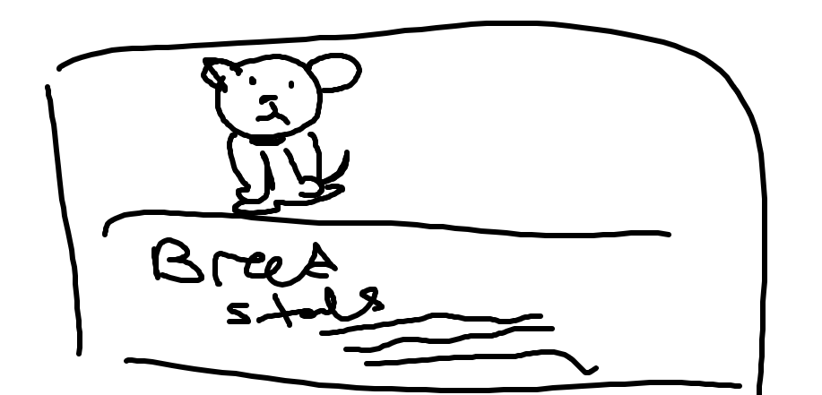
Doggos!
Dog Breed Info
Choose your favorite breed! (drop down)

Slide 3
Doggos!
Find your perfect dog!
hypoallergenic
intelligence
gentle
active
Etc…
Choose Three characteristics
List of
Dog breeds
With
The three characteristics chosen

Slide 4
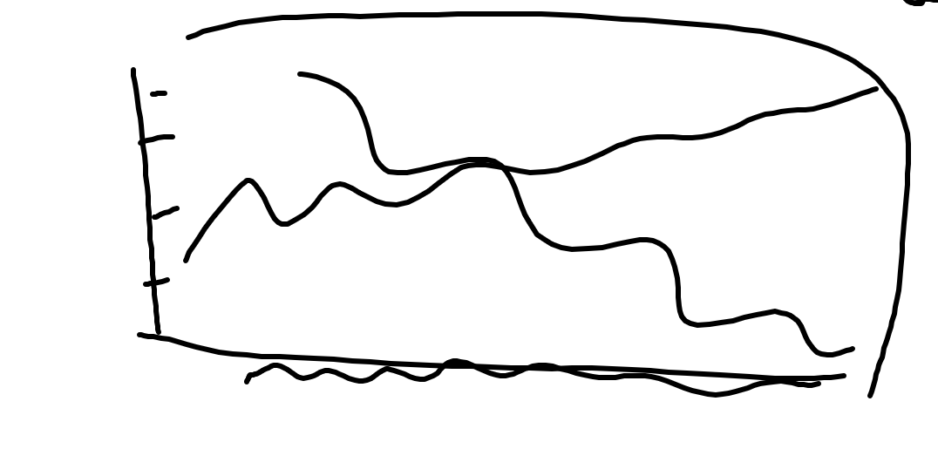
Doggos!
Compare doggo data
Choose two characteristic you’re interested in!
Weight (drop down)
vs
Life span (drop down)
Type of chart (drop down)

Slide 5

Doggos!
Dungeons & Doggos! (stretch goal)
Choose your doggo!
chihuaha the mighty
Golden wizard retriever
Samoyed snow demon
Etc…
Battle! (button)

